Slide 1
telescience WG Update
Fang Pang Lin
Shinji Shimojo
Pragma 25

Slide 2
Challenge
Can we use Pragma Cloud?
Requirement?: security?, performance? Sustainability?, Reliability?
We will be joining with GeoScience WG
Funding?
CPS (Cyber Physical System) Project started in Japan.
Disaster management information platform will start next January in Taiwan
Flood modeling and Coral reef ecological monitoring in Thailand.
TEIN or APAN
Data infrastructure Meeting: 4-6, December@Taichung
Theme: "Bridging Big Data Infrastructures: Expeditions in the Network Science Landscape"

Slide 3
Short term goal
find collaborative project with pragma resource
Collaboration with Museums
Use of Android devices
introduction of SDN into visualization
Long term goal
build common infrastructure for telescience and geoscience WG and more.

Slide 4
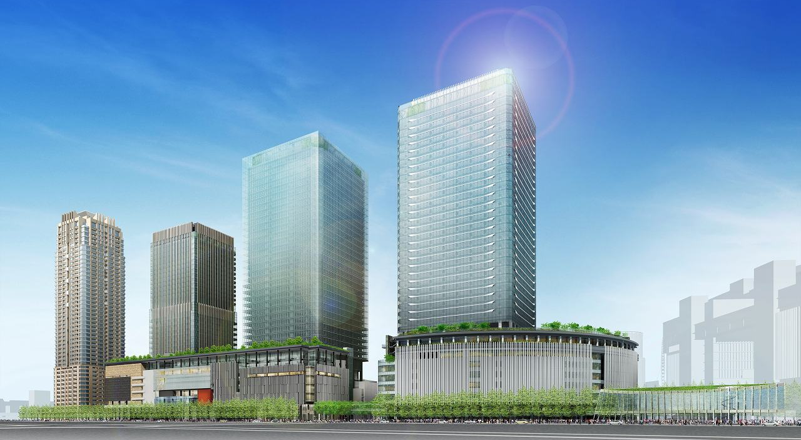


Copyright (C) 2011 Knowledge Capital Management Corporation. All Rights Reserved.
Open on 26th March 2013
Umekita Phase 1 Development Area Project GRAND FRONT OSAKA
http://kc-i.jp/
Notes:
Today, I really appreciate this opportunity to introduce about our project, Knowledge Capital of Grand Front Osaka.

Slide 5
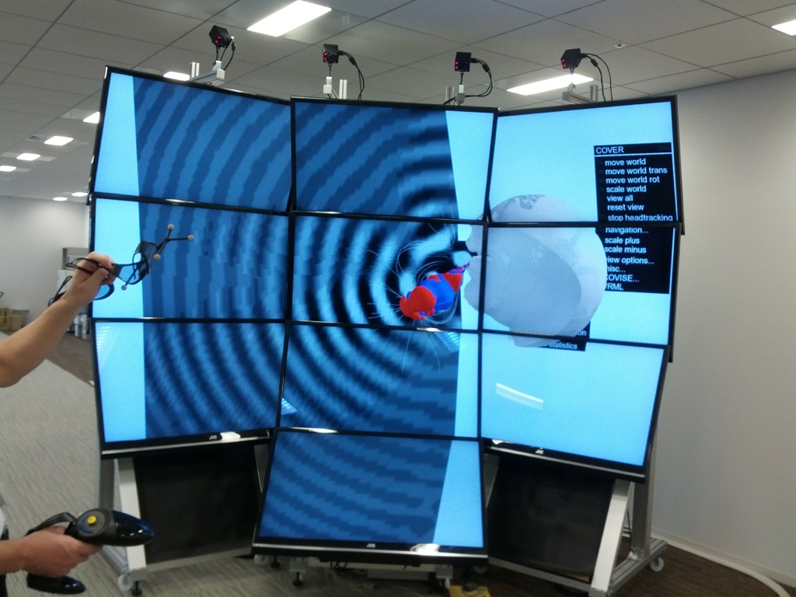

Slide 6
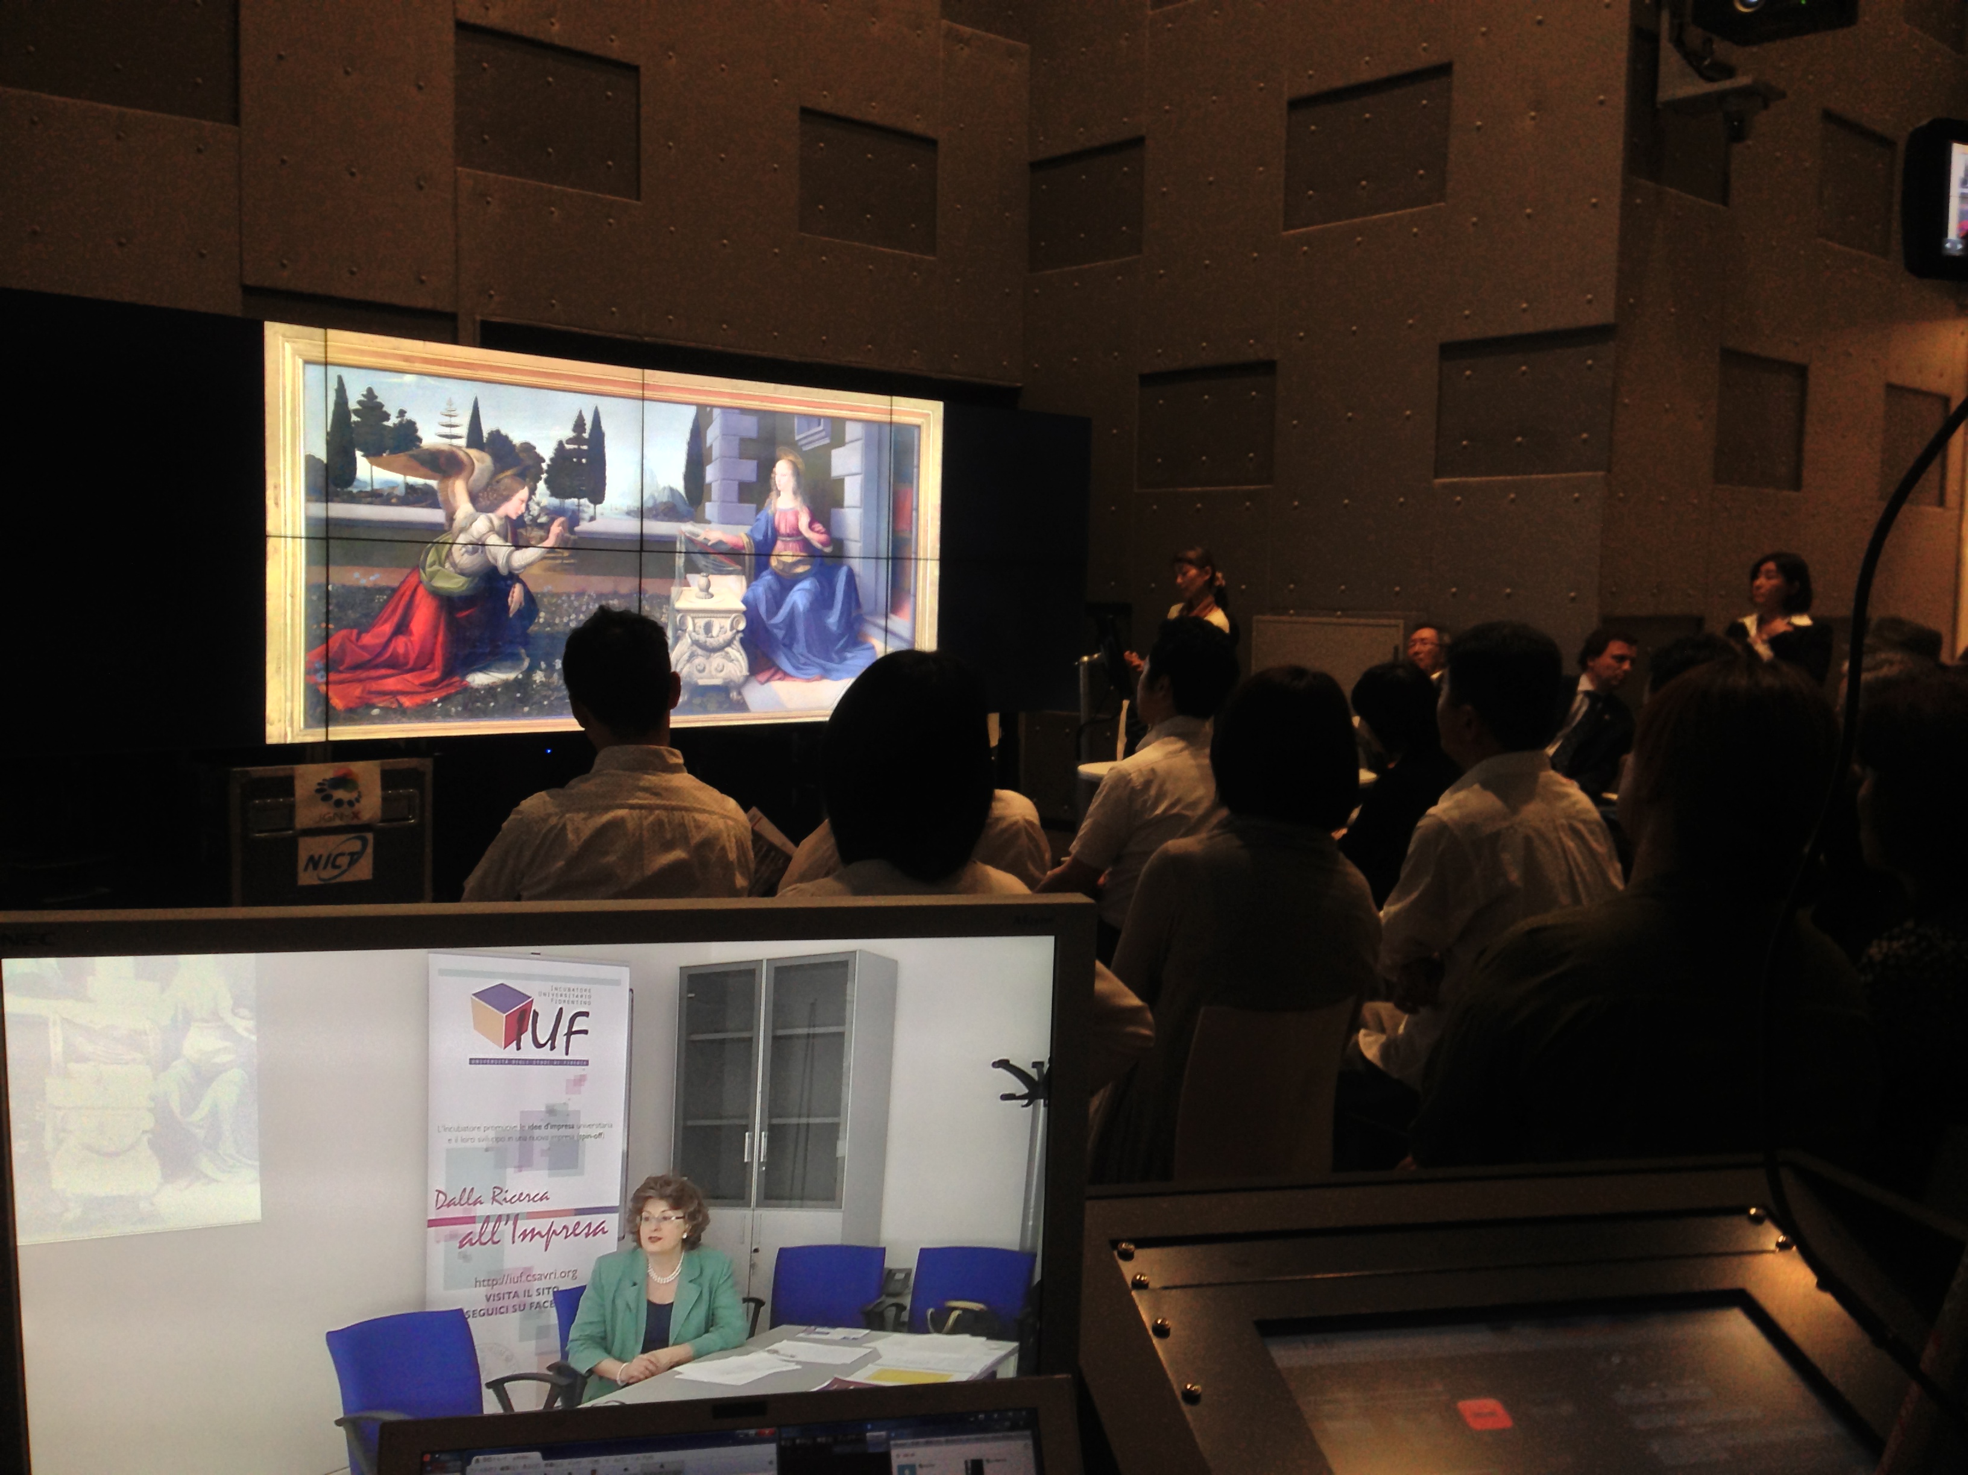
Italy and Japan collaborative event “Art and Science”

Slide 7
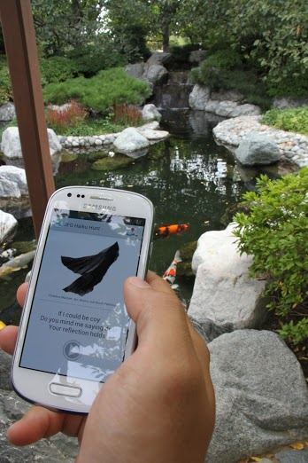
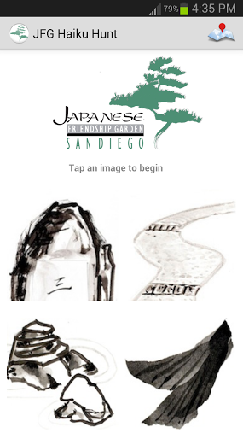
JFG Haiku Hunt (San Kai En)
Prime 2013 Jesus Rios

Slide 8
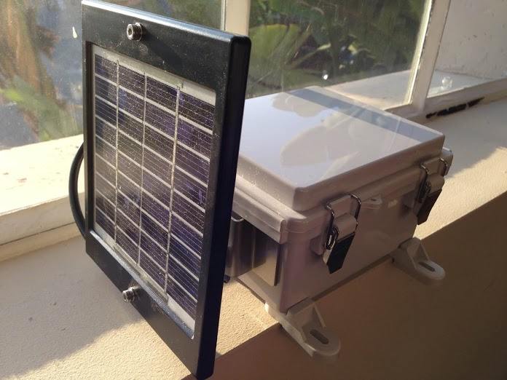
JFG Haiku Hunt (San Kai En)
Solar powered PlaceSticker device (ISID, Tokyo, Japan)

Slide 9
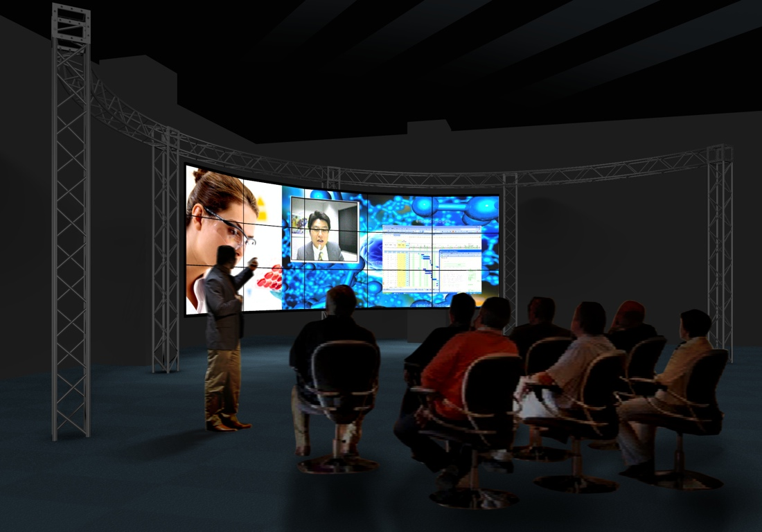
15 tiles large wall

Slide 10
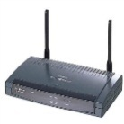
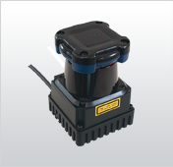
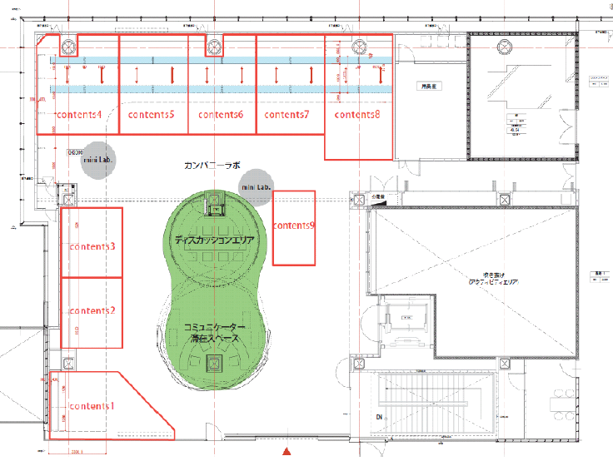
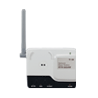
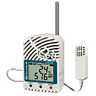
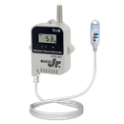
3F
device C（AC・LAN）ｘ４
（2.4GHz transmit）
device B（AC・LAN）ｘ４
C
A1
B
C
B
device A1（AC・LAN）ｘ２
（429MHz transmit）
deviceA2（AC）ｘ２
（ 429MHz transmission）
B
device A3（battery）ｘ多数 （ 429MHz transmission）
C
B

Slide 11

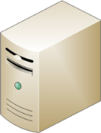
System Architecture
Obstacle
Beacon
Beacon Records
WLAN AP
LRS
Position Data
Server
11
Notes:
システムのイメージはこのようになります
図の四角い空間が計測対象領域で，空間内には歩行者，障害物が存在しています．
システムは，レンジスキャナと無線LANのアクセスポイント，歩行者の持つケータイ，サーバで構成され，集中処理を行います．
レンジスキャナは，計測領域内をスキャンし，検出した歩行者の位置情報をサーバに送信します．
歩行者は領域内を動き，保持するケータイの短距離通信機能を用いて定期的に周囲の端末にビーコンを送信します．
受信したビーコンの情報は定期的に無線LANのアクセスポイントを通してサーバに送信します．
サーバは送られてくる位置情報と受信ビーコン情報を用いて，マッチング処理を行います．
(5.34)

Slide 12
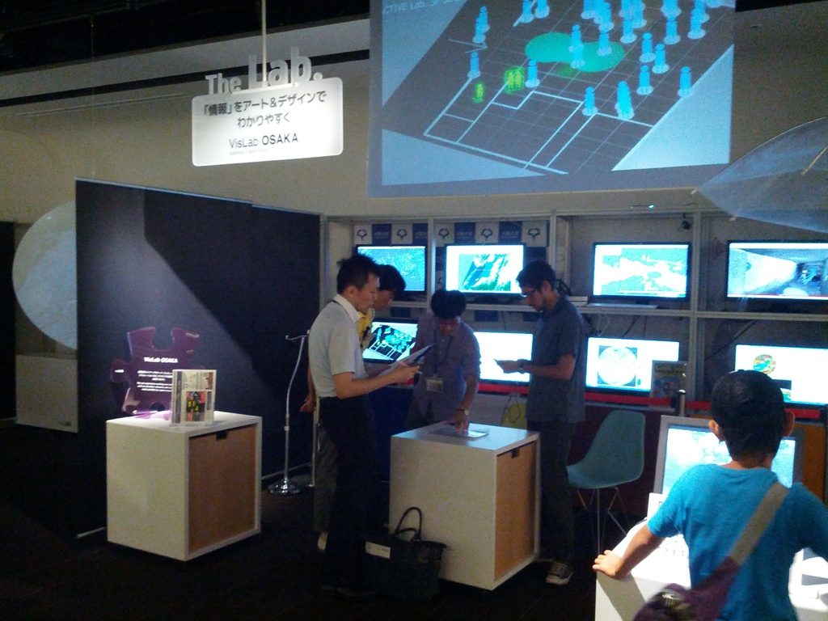

Slide 13
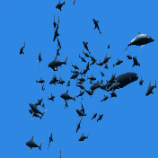
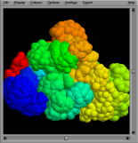
Demo Plan at SC13
KIDO, etc.
Network failure avoidance on wide area network
Denver, US
Umekita, JP
NTU, SG
AP Server
AP Server
Buffering
Server
Buffering
Server
Buffering
Server
Ｘ
Ｘ
AP Server
RISE

Slide 14
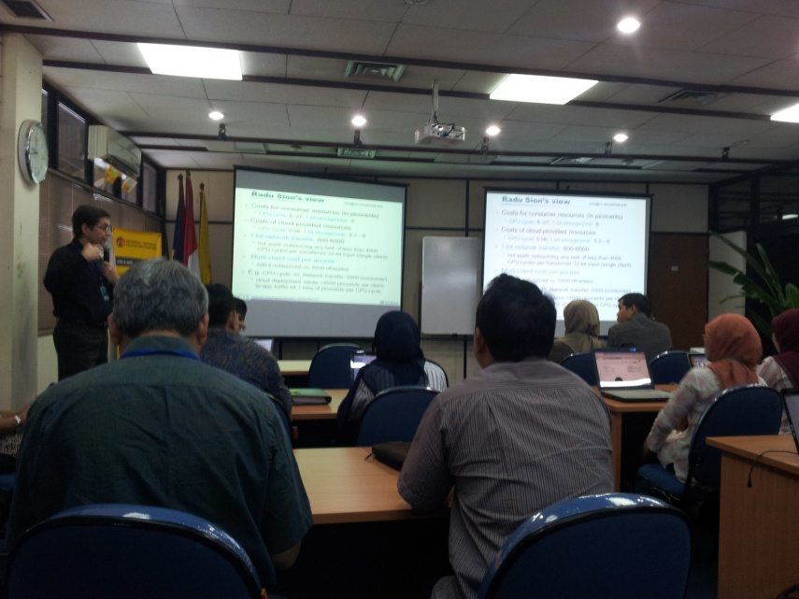
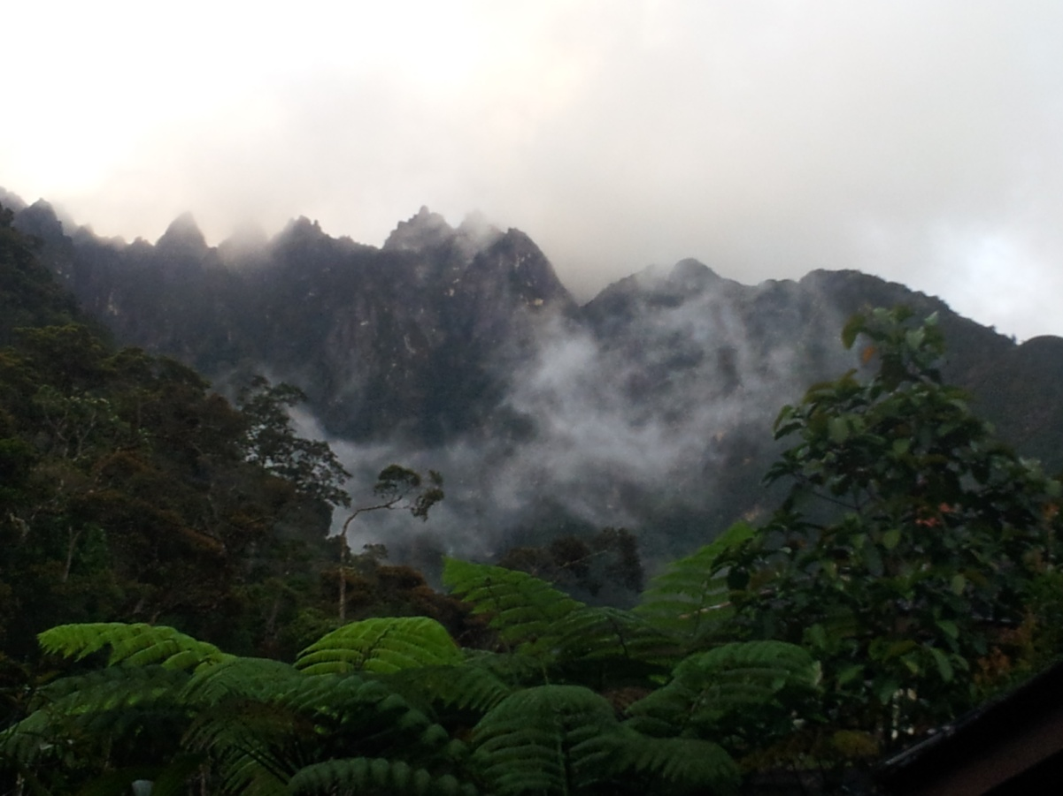
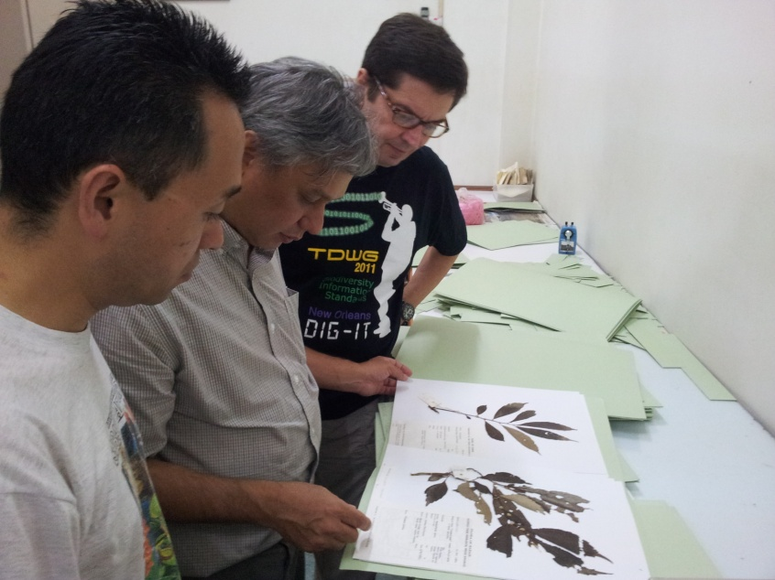
Mini-PRAGMA in Jakada & Kinabalu Biodiveristy Expedition: Biodiversity+Telescience (June,2013)

Slide 15
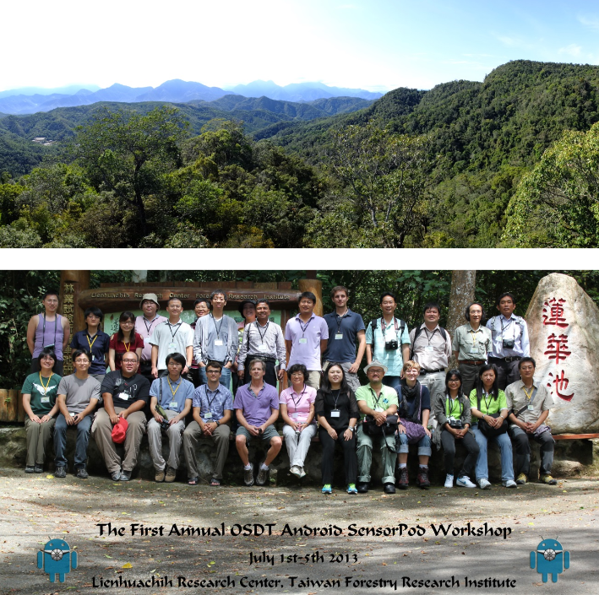
Mobile device Technology
First OSDT Android SensorPod Workshop. 1-5 July 2013, TFRI, Taiwan
To facilitate the exchange of ideas, data, technologies, and methods for using wireless sensor networks for environmental science applications
To identify common scientific agendas and initiate cross-site data analysis applications and collaborations
To reduce the fragmentation of technology and infrastructure in environmental science research groups
To provide international research experience to undergraduate and graduate students in environmental science and sensor network technologies
To enhance existing collaborations and to create new opportunities for technology sharing and scientific research

Slide 16
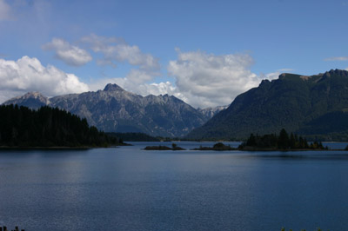
GLEON 15 Meeting
November 4-8, Bahia Blanca, Argentina
General global collaboration in Limnology.
Form new community Networking Lake Observatories in Europe
Student community working with high frequency data
Heading towards new and sustainable organizational funding structure.

Slide 17
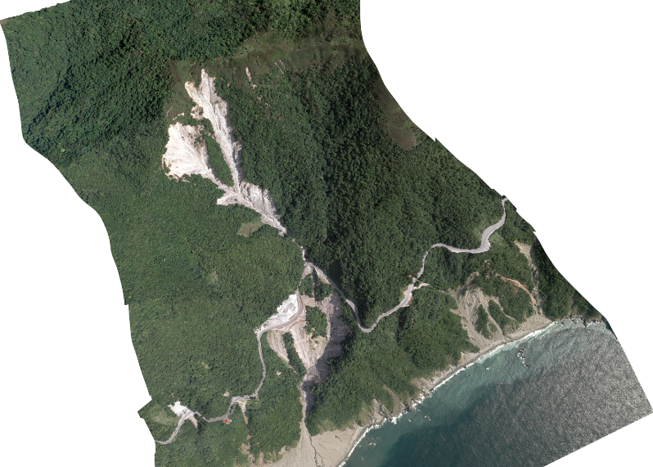
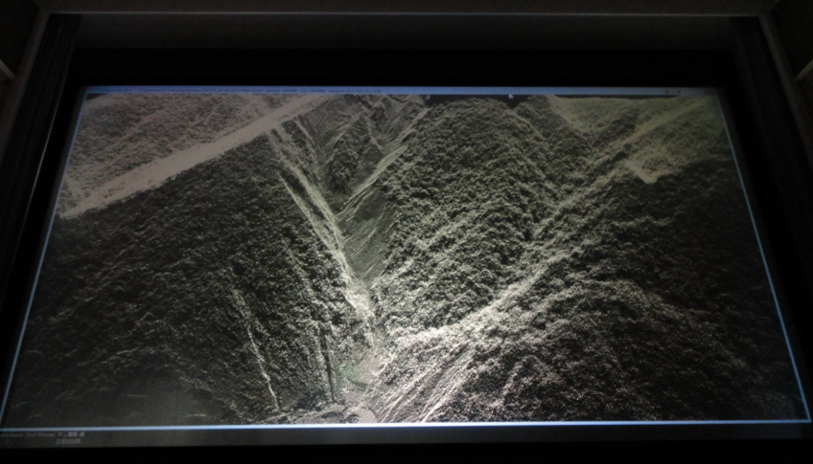
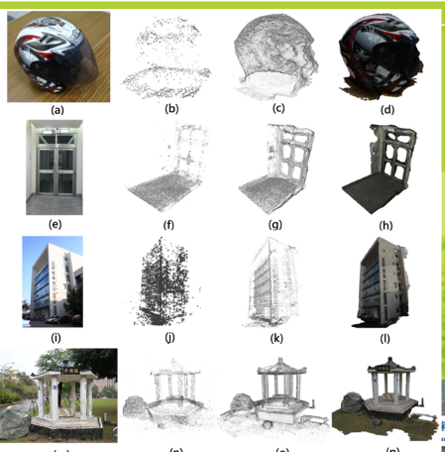
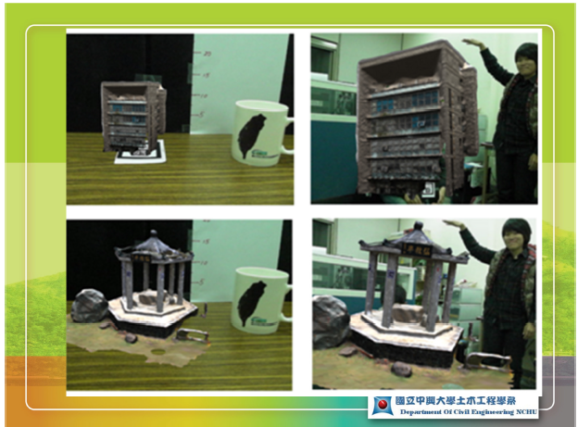
Large Data Visualization & AR: 4K Projection: Large LiDar Point Cloud + SAGE
Source: Srong Engineering Consulting Co, Ltd., Taiwan & Prof. MD Yang, NCHU

Slide 18

Southeast Asia Joint Discovery (2-6, Dec)

Slide 19
Structure
Day 1
information exchange
Day2
Discussion for collaborative project.
Joint with GeoScience WG

